Slide 1
Capstone Project

Slide 2

TABLE OF CONTENTS
01
02
03
Introduction/Business Problem
Data Section
Methodology Section
04
05
06
Results
Discussion
Conclusion

Slide 3
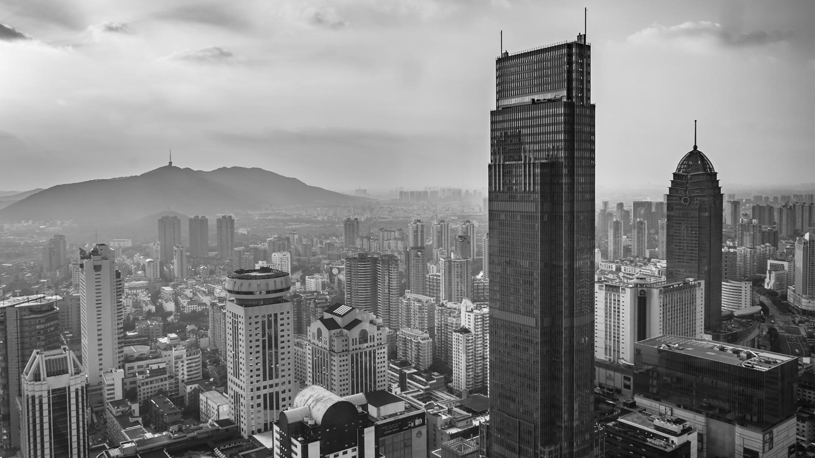
Introduction/Business Problem
01

Slide 4

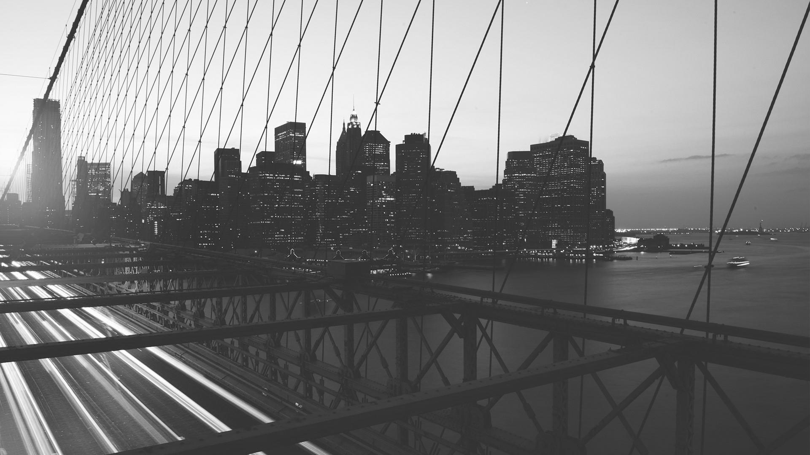
Objectives
People planning to migrate to Toronto Canada might be interested to get details of the various venues available at various Toronto neighborhoods
Knowledge and awareness of the various facilities and venues such as Supermarkets, bars, pubs, medical facilities will help the singles, couples or families to make an informed decision before choosing a neighborhood for settlement or stay
Intended audience for the study are people who are interested to know what each Toronto neighborhood has to offer to its residents. So, the audience can be people who are planning to migrate or people who are planning for a short or long term stays in Toronto

Slide 5

Data Section
02

Slide 6
Data
1
2
3
4
5
Toronto neighborhood and venue details are considered
Data is collected from Foursquare API
Data is collected from Wikipedia
Data is also scraped from websites
Missing data were dropped/ignored

Slide 7

Methodology
03

Slide 8
Analytic Approach
As a part of this study, prescriptive analytics is being used to help someone identify the various venues and or resources that various neighborhoods has to offer.
K-means clustering was used to develop 5 clusters around the city of Toronto.
Each of the clusters were then analyzed to identify the various resources, entertainment centers, supermarkets etc. available in that cluster.

Slide 9
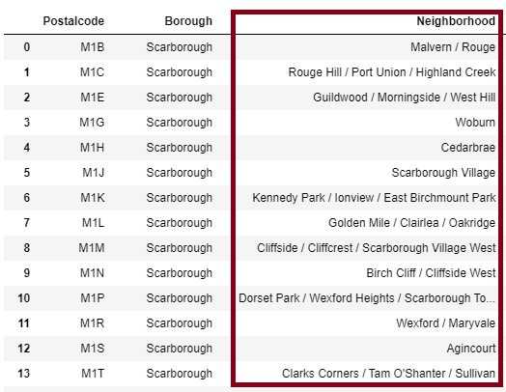
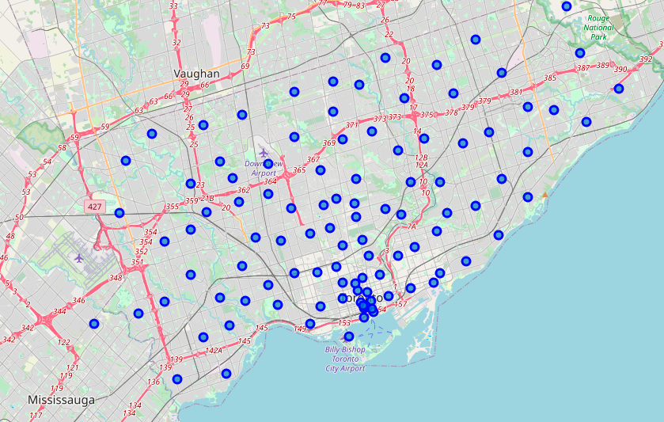
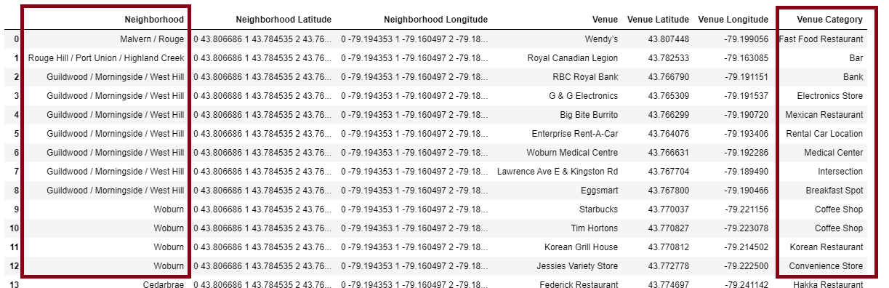
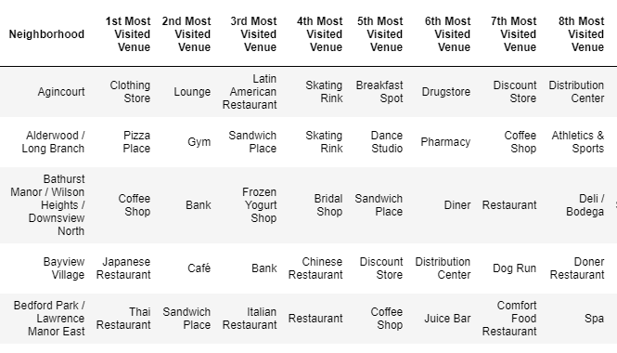
Analysis data for Toronto Neighborhoods

Slide 10
04
Results

Slide 11
RESULTS
Venues analyzed for various neighborhood
Most visited venues are identified for each neighborhood is identified
Venues per clusters is also analyzed with fruitful insights
Toronto Neighborhood data ia analysed and useful insights are identified
1
2
3
4

Slide 12
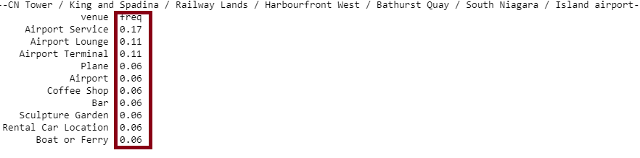
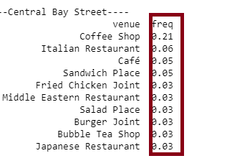
Some insights from the results
The neighborhood around CN tower or Railway Lands has Airport service and Airport lounge more frequently available. However, the rental car locations or boats or ferry are frequency is lesser.
The Central Bay street neighborhood has more coffee shops that would attract the office goers and the students. However, the Japanese restaurants are very less in that area.

Slide 13

05
Discussion

Slide 14
Discussion
Based on the analysis, we can identify the number of venues based on the categories for each neighborhood.
This demonstrates the venues and the resources that each neighborhood has to offer for the residents.
Based on these details, people (the intended audience for this study), who have decided to migrate to Toronto, Canada can go through the analysis data and then make an informed decision while selecting a neighborhood for settling down.
For example, for Alderwood/Long branch, the Pizza Place is the most visited venue. Similarly, for Bayview village, the Japanese restaurant is the most visited place. For Bathurst Manor, the Coffee shop is the most visited place followed by Banks. Hence, there is a higher probability of having banking services available.

Slide 15

06
Conclusion

Slide 16
Conclusion
Existing data from Wikipedia was used in associated with data from Foursquare API and scraped data from website
Exploratory Data analysis and clustering techniques were used
Various aspects of Toronto neighborhood was verified and analyzed
This study will be helpful for people who are planning to migrate and settle in Toronto
Satisfactory answers were achieved for the questions posed before the study

Slide 17

THANKS

